Slide 1
.NET Framework
.NET is a framework to develop software applications. It is designed and developed by Microsoft and the first beta version released in 2000.
It is used to develop applications for web, Windows, phone.
The .Net Framework supports more than 60 programming languages such as C#, F#, VB.NET, J#, VC++, JScript.NET, APL, COBOL, Perl, Oberon, ML, Pascal, Eiffel, Smalltalk, Python, Cobra, ADA, etc.
The .Net Framework have some components are :
1)Common Language Runtime(CLR)
2)Framework Class Library(FCL)
3)Core Languages
4)Modules

Slide 2
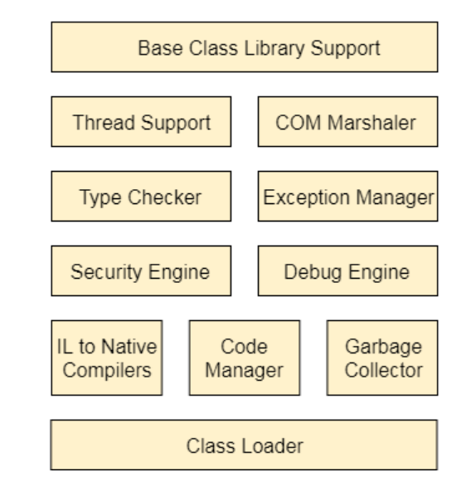
Common Language Runtime(CLC):
It is a program execution that loads the data and executes the program andacts as middleware between framework and operating system.
It does exception handling, memory management, and garbage collection.

Slide 3
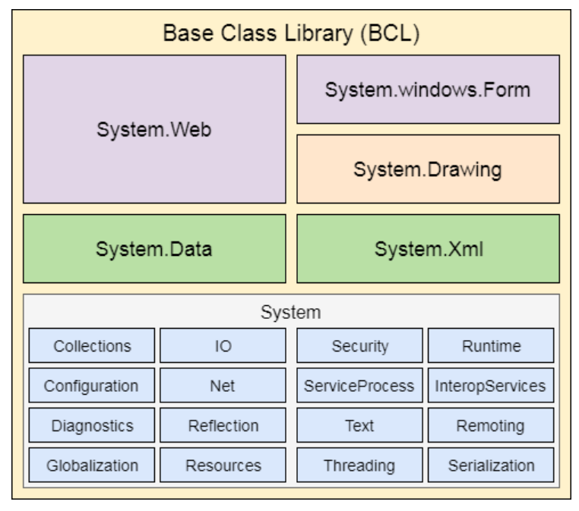
Framework Class Library(FCL):
Framework Class Library is standard library that is a collection of thousands of classes and used to build an application.
Base Class Library is the main class of the FCL and provide the functionalities.

Slide 4

Core Languages :
It is the basic part of programming language and to solve the data structure problems.
Core Languages has some frameworks such as WinForms, ASP.NET and ADO.NET
WinForms: Windows Forms is a smart client technology for the .NET Framework, a set of managed libraries that simplify common application tasks such as reading and writing to the file system.
ASP.NET: ASP.NET is a web framework designed and developed by Microsoft. It is used to develop websites, web applications, and web services.
ADO.NET:ADO.NET is a module of .Net Framework, which is used to establish a connection between application and data sources.

Slide 5
MODULES:
In this Module , we have some applications such as WCF,WPF,WF,LINQ, Entity Framework, Parallel LINQ .
Windows Communication Foundation(WCF):
It is a framework for building service-oriented applications and can send data as asynchronous messages .
Windows Presentation Foundation(WPF):
Windows Presentation Foundation (WPF) is a graphical subsystem by Microsoft for rendering user interfaces in Windows-based application.
Workflow Foundation(WF):
Windows Workflow Foundation (WF) is a Microsoft technology that provides an API, an in-process workflow engine, and a rehostable designer to implement long-running processes as workflows within .NET applications.
Language Integrated Query(LINQ):
LINQ is query language and used to make the query for data sources with C# or Visual Basics programming languages.

Slide 6
Entity Framework:
It’s open source framework which is used to work with a database using .NET objects .
Parallel LINQ:
Parallel LINQ or PLINQ is a parallel implementation of LINQ to objects and combines the simplicity and readability of LINQ and provides the power of parallel programming.

